Slide 1
WELCOME
all teachers to our class today!

Slide 2
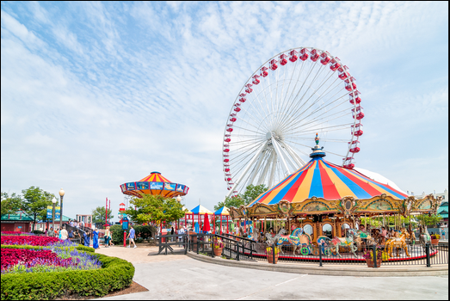
Look at the picture and say the word
Amusement park

Slide 3
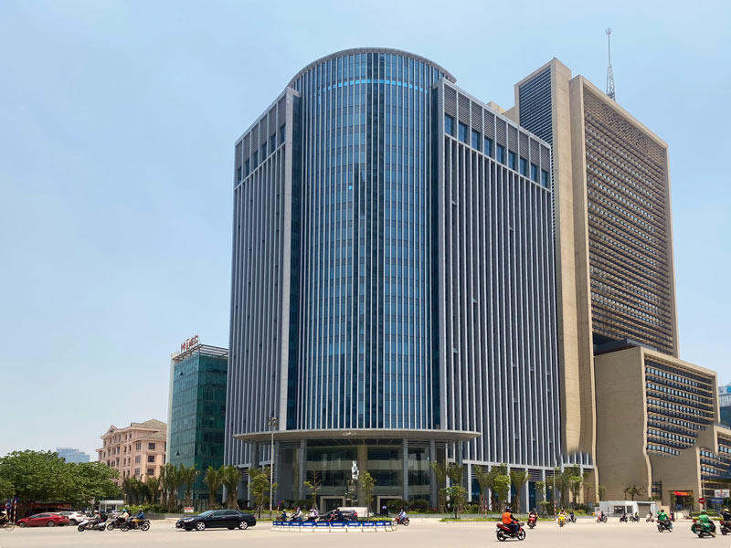
Look at the picture and say the word
building

Slide 4
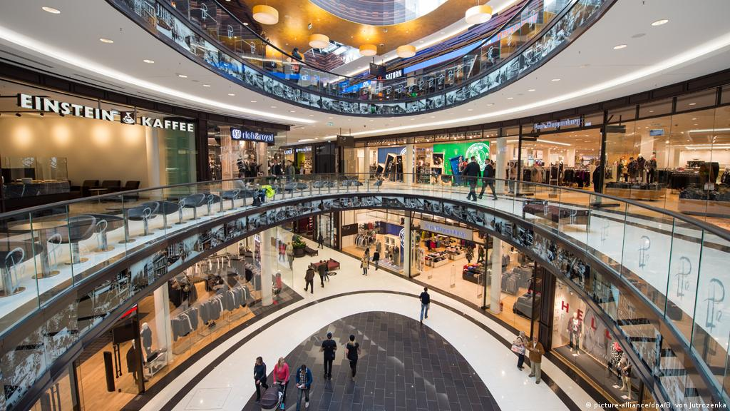
Look at the picture and say the word
Shopping mall

Slide 5
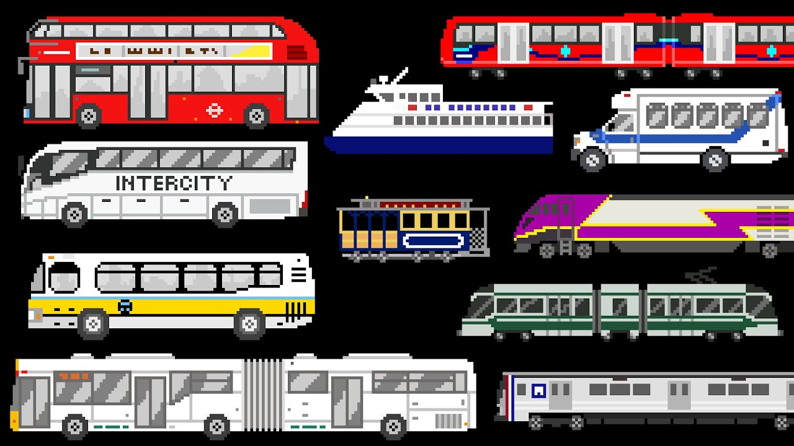
Look at the picture and say the word
Public transportation system

Slide 6
Lesson 2
PERIOD 5: Grammar + Pronunciation

Slide 7
Lesson 2

Slide 8
Lesson 2

Slide 9
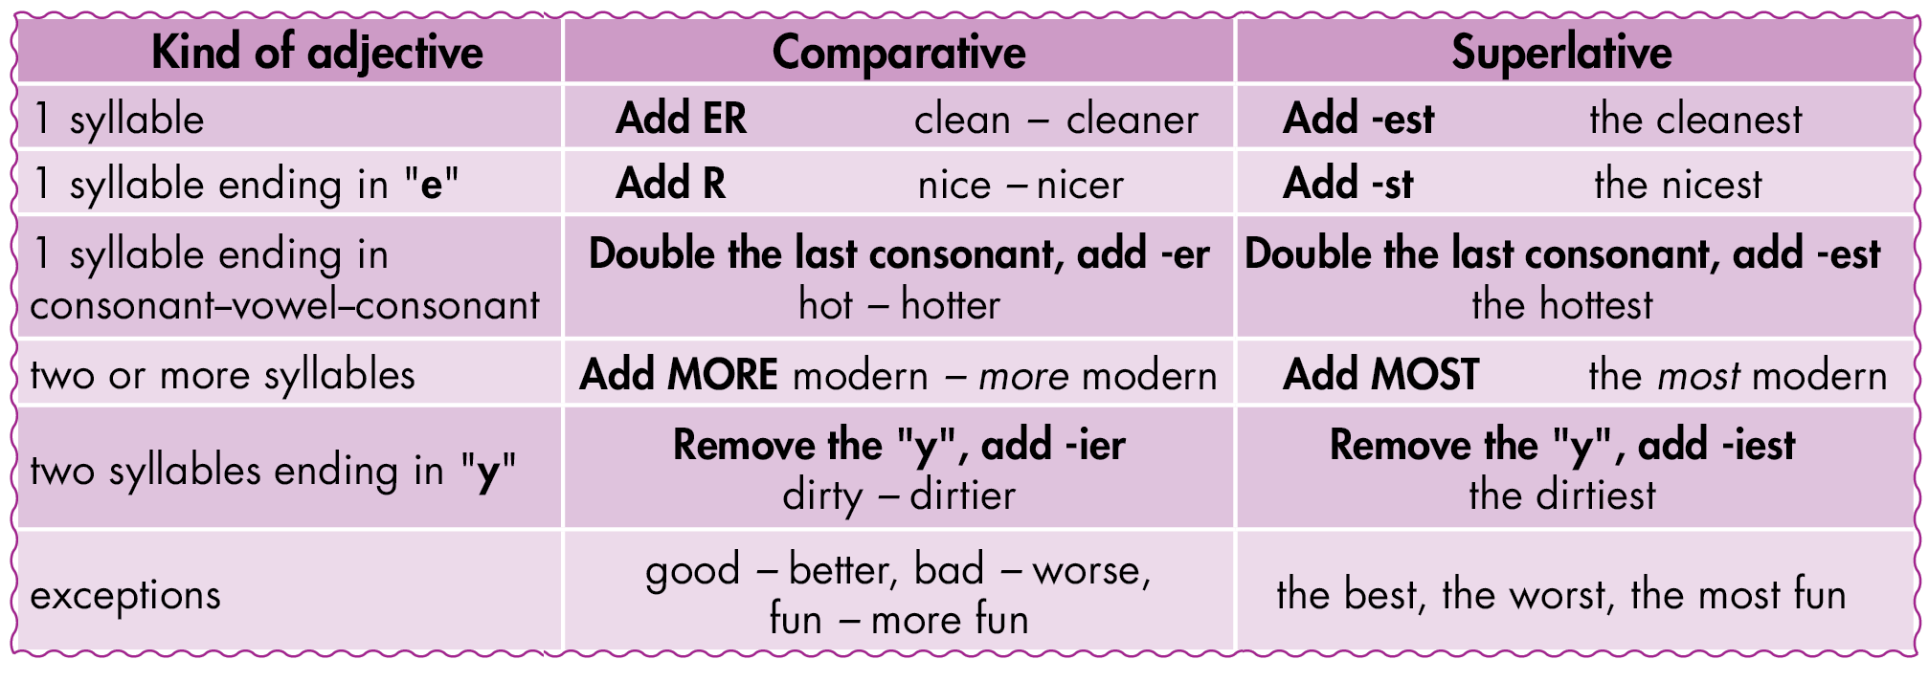
Lesson 2

Slide 10
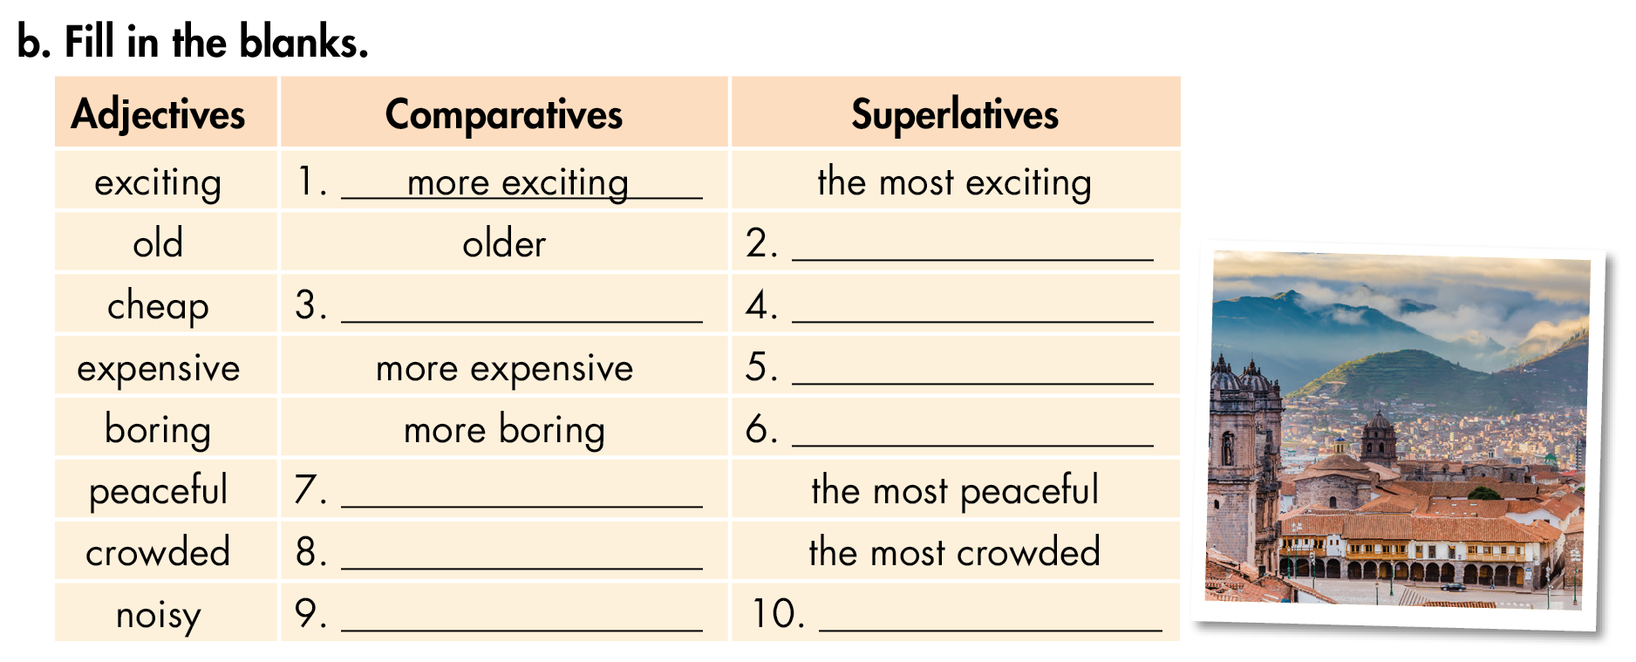
Lesson 2
the oldest
cheaper
the cheapest
the most expensive
the most boring
more peaceful
more crowded
noisier
the noisiest

Slide 11
Lesson 2
the most crowded
more peaceful
coldest
more modern

Slide 12
Lesson 2

Slide 13
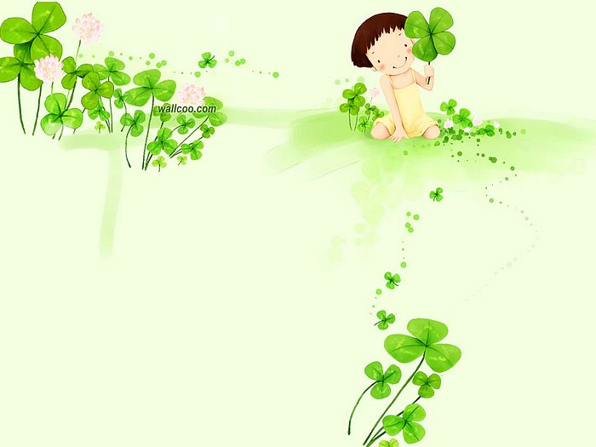
Home Work
- Learn by heart Grammar
- Do exercise in workbook

Slide 14
See you again !
Thanks for your attention

